Slide 1

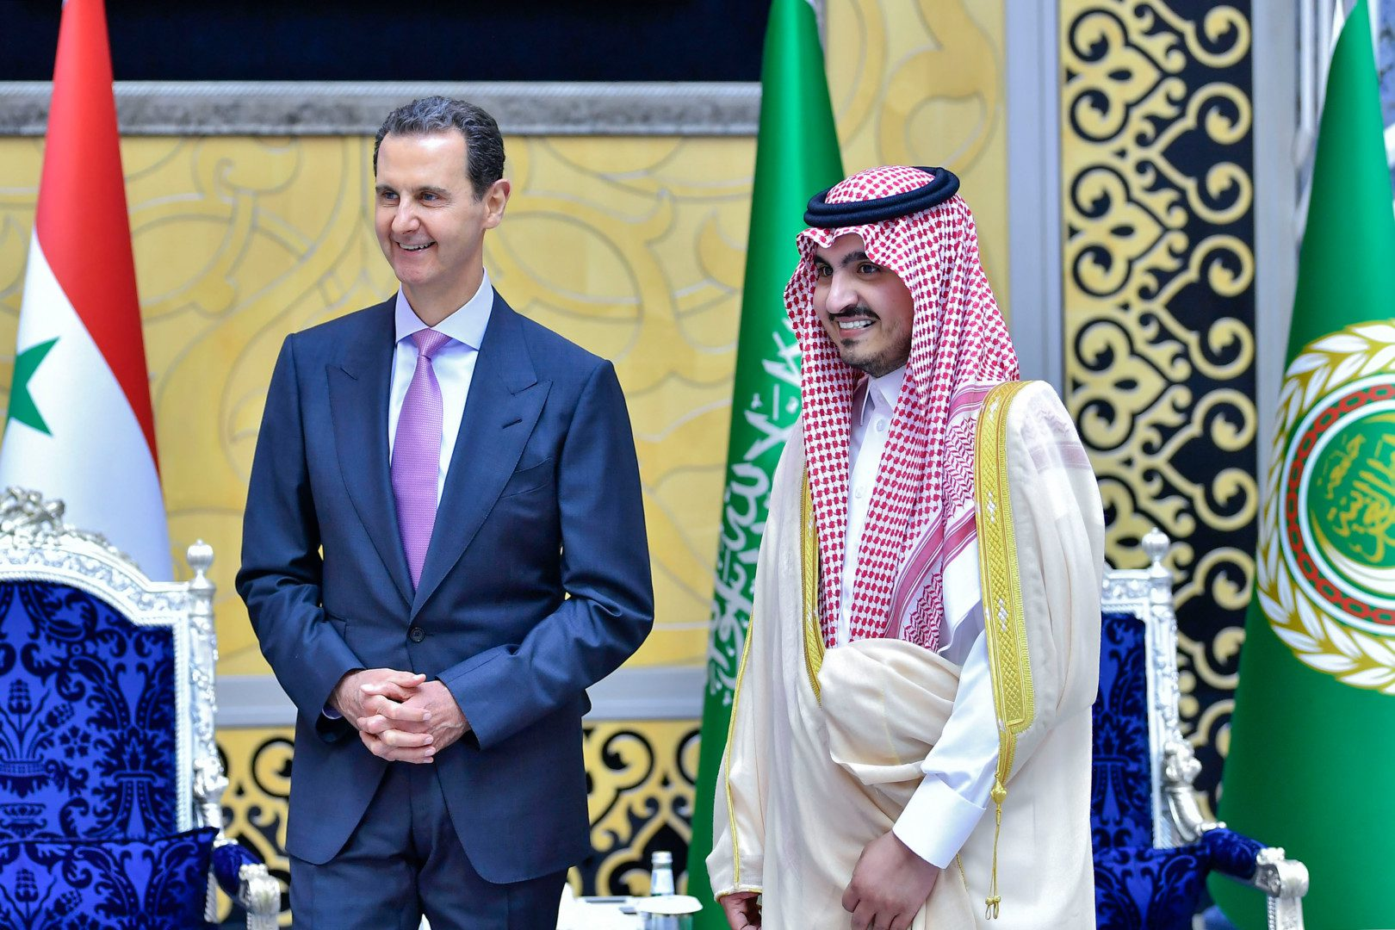
arab league voted to
reinstate SYRIA`S MEMBERSHIP
AFTER 12-YEAR SUSPENSION
VAGANOVA O.
GROUP №3834101\30001

Slide 2
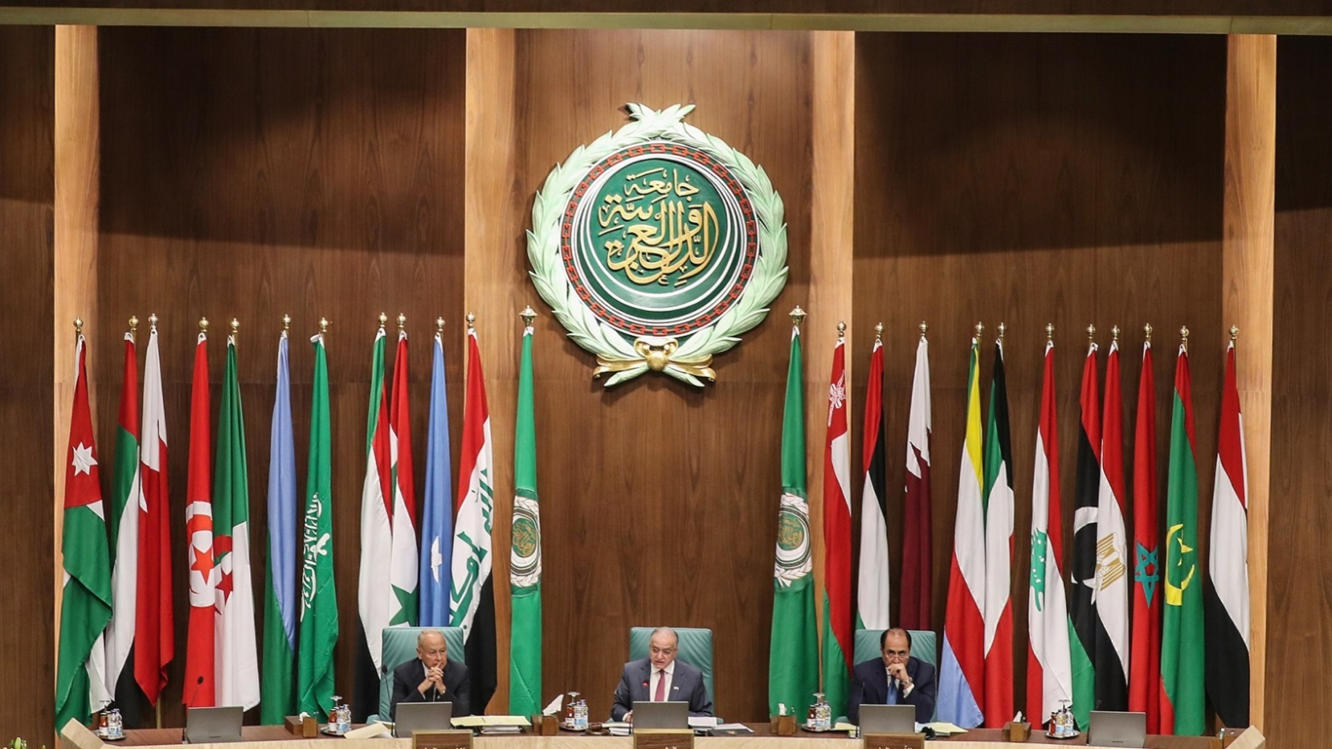
ARAB LEAGUE
“
Arab government representatives in Cairo voted on May 7th to return Syria to the Arab League after a 12-year suspension.

Slide 3
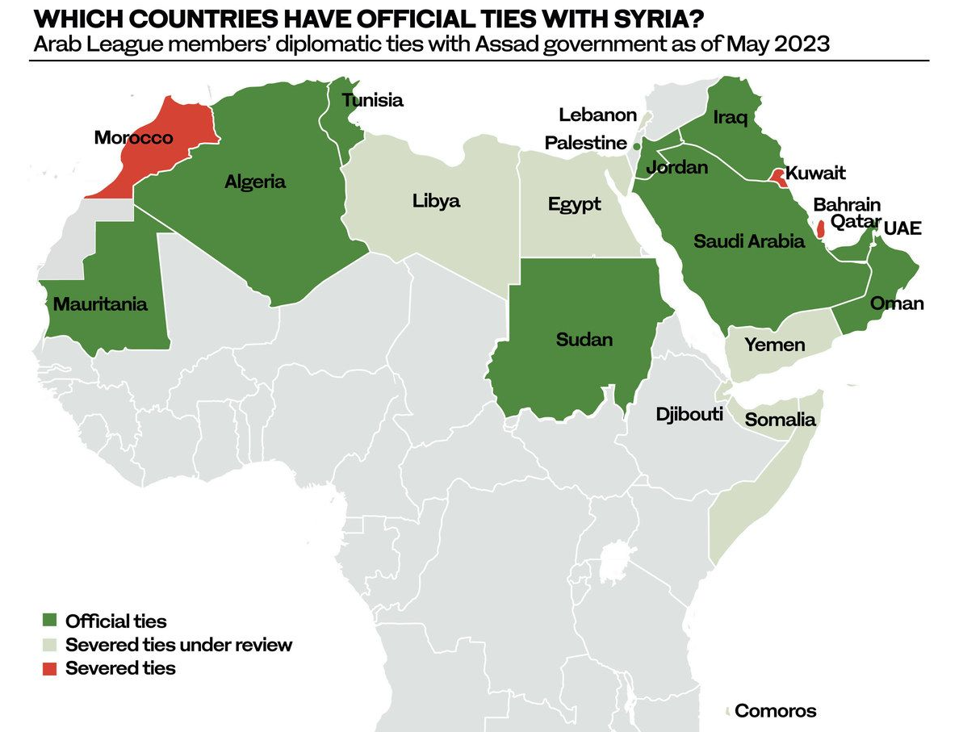
ARAB LEAGUE

Slide 4
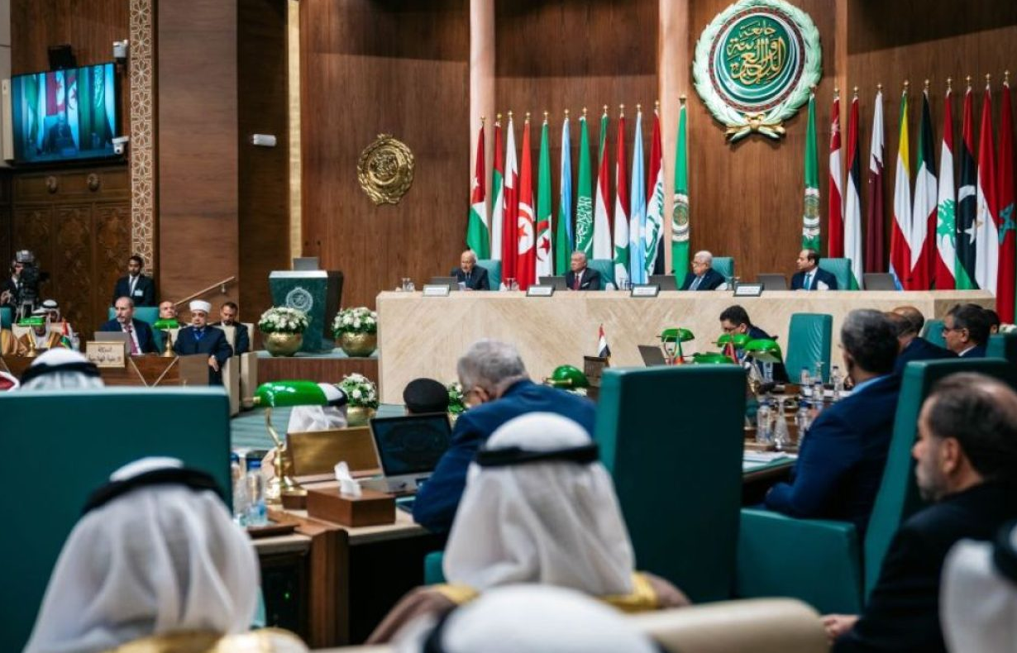
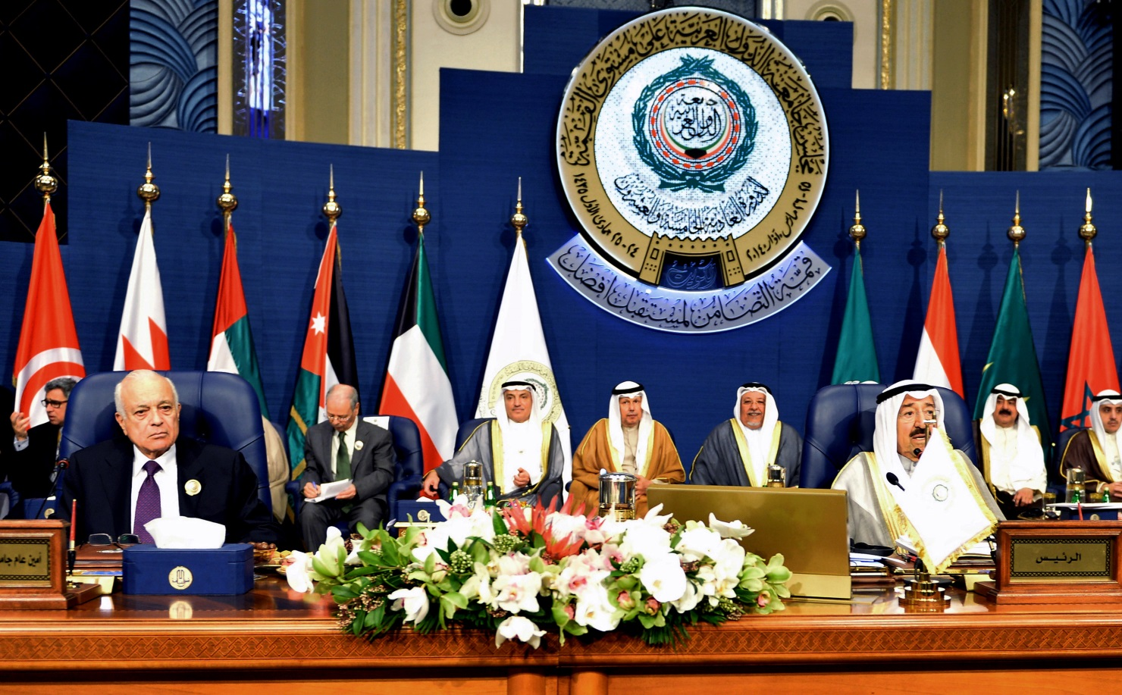
ARAB LEAGUE
All 13 of the 22 member states that
attended the session endorsed the
decision. The Arab League generally
tries to reach agreements by
consensus but sometimes opts for
simple majorities.

Slide 5
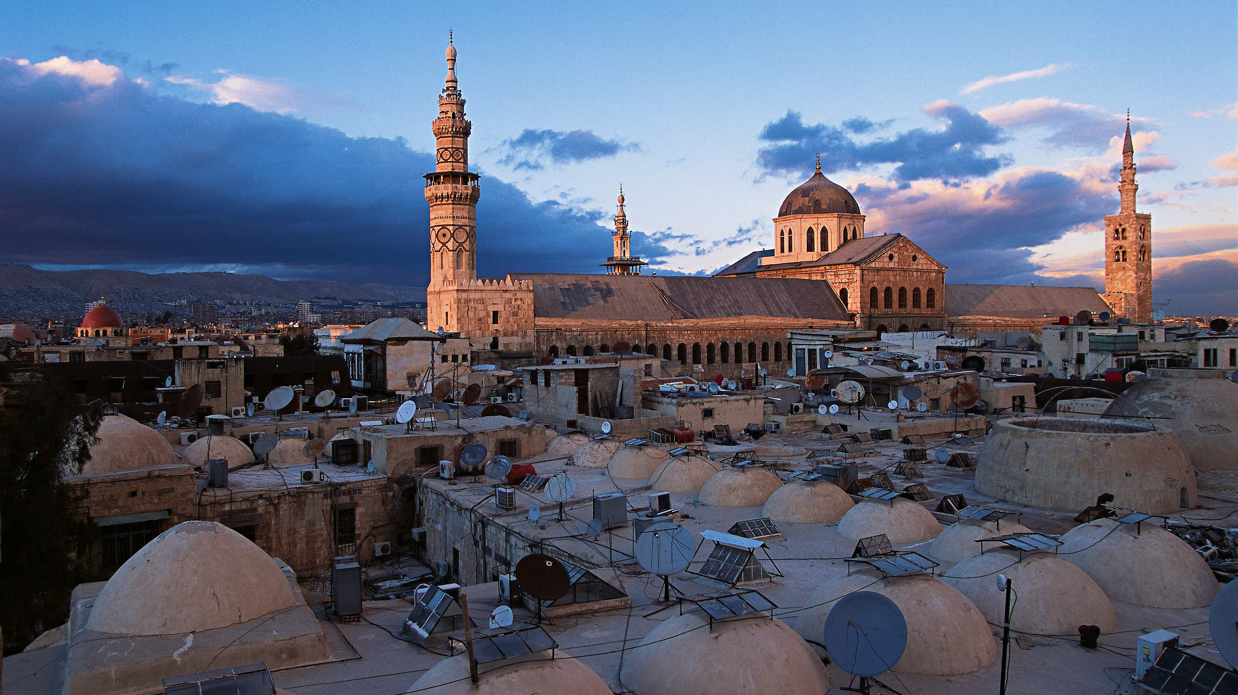
There is still no Arab consensus on normalization with Damascus. Several governments did not attend the meeting. Among the most notable absentees was Qatar, which continues to back opposition groups against Syrian President Bashar Assad’s government, and continues to resist normalization with Damascus.
.

Slide 6
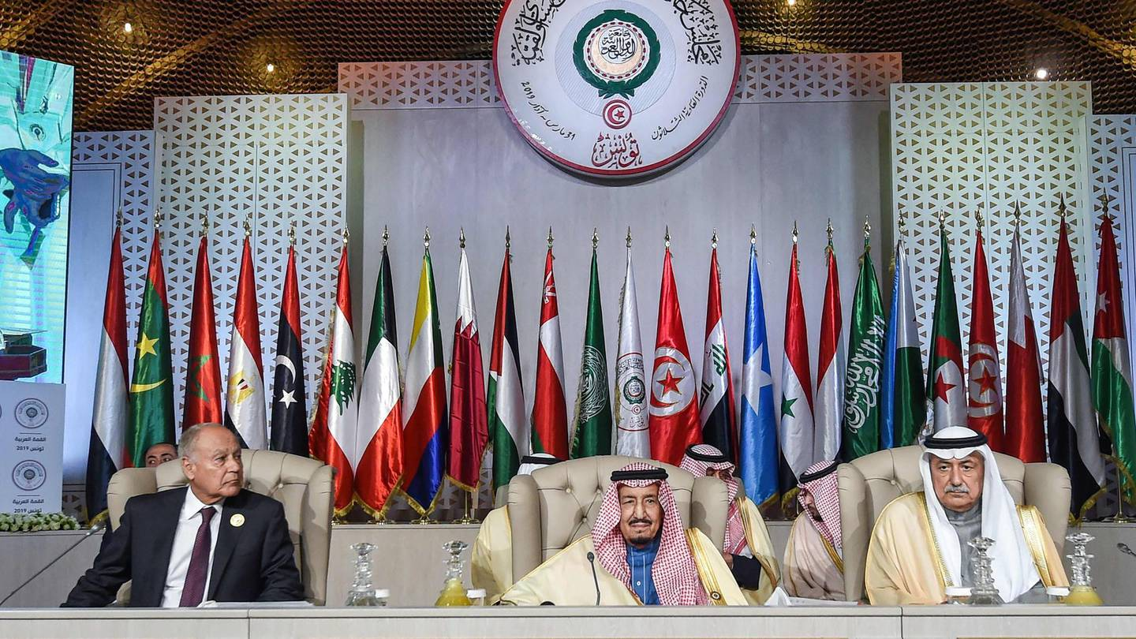
SYRIA IN ARAB LEAGUE
The decision for Syria to return also includes a commitment to ongoing dialogue with Arab governments to gradually reach a political solution to the conflict, in line with United Nations Security Council Resolution 2254. The Arab League in the decision also set up a communications committee consisting of Saudi Arabia and Syria`s neighbors Lebanon, Jordan and Iraq to follow up on developments.

Slide 7
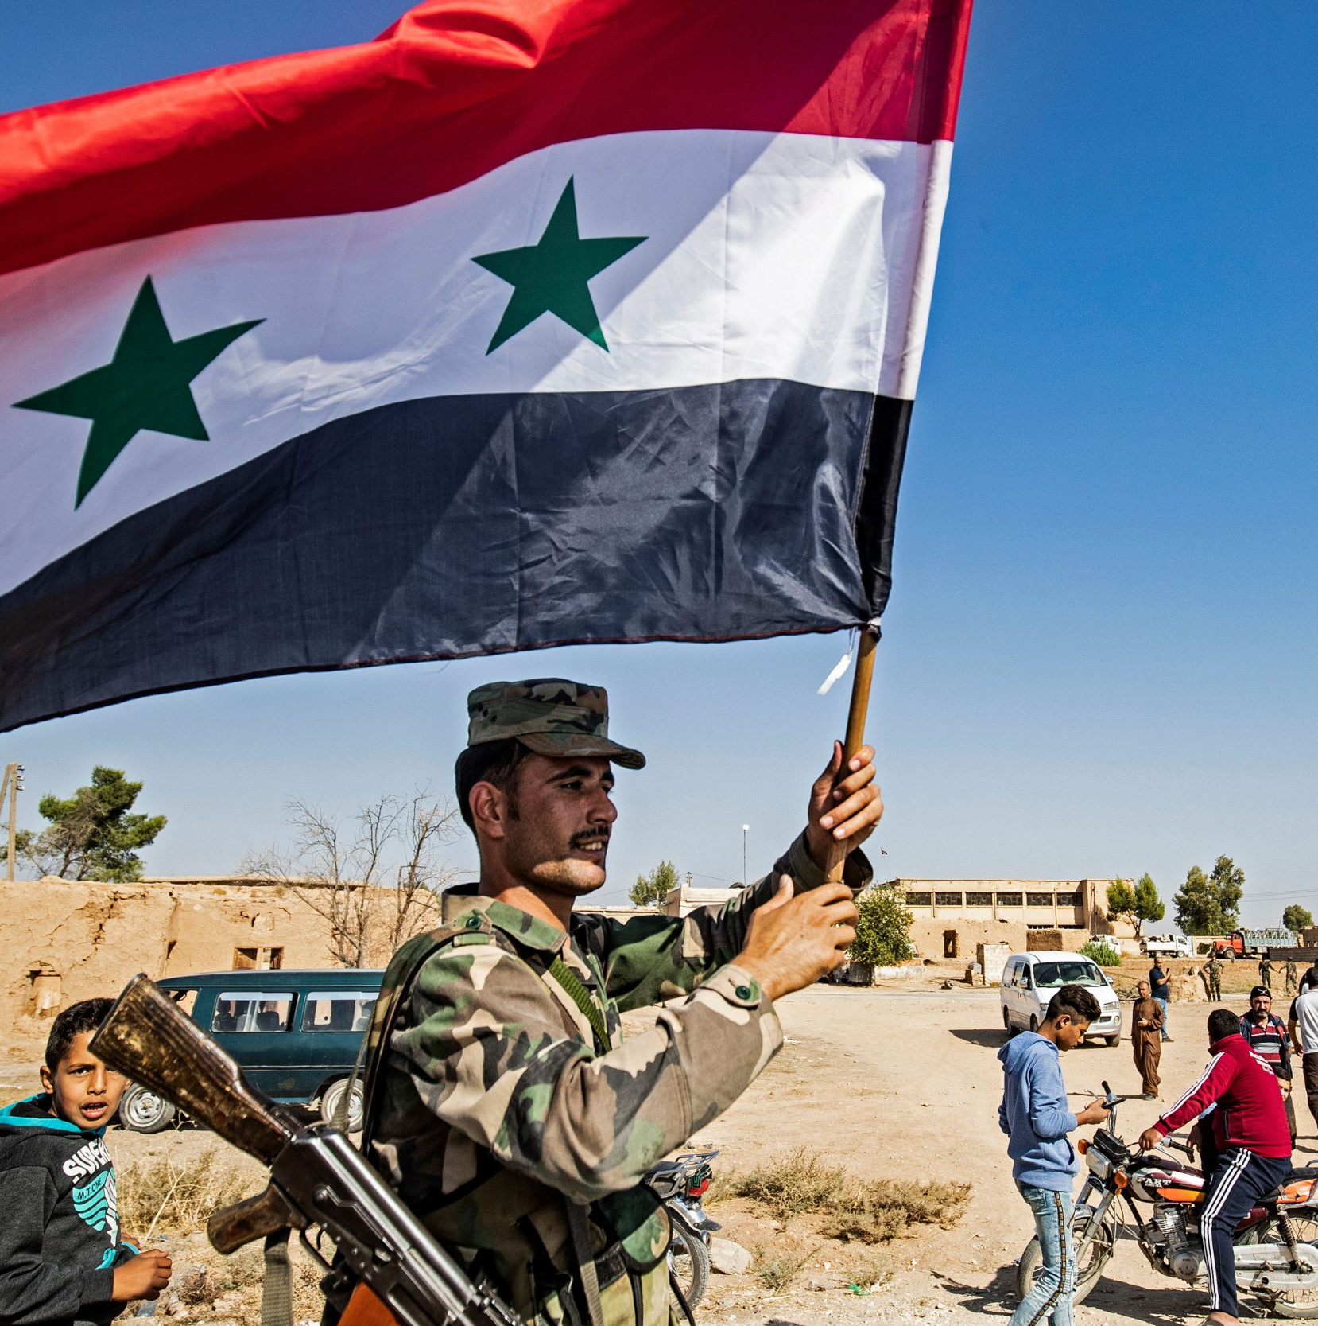


RESOLVE CRISES
In addition to commitments to a gradual resolution to the conflict, the decision also welcomed the Syrian government`s willingness to cooperate with Arab countries to resolve “humanitarian, security, and political” crises that affected Syria and the region due to the conflict-namely refugees, “the threat of terrorism and drug smuggling.”

Slide 8
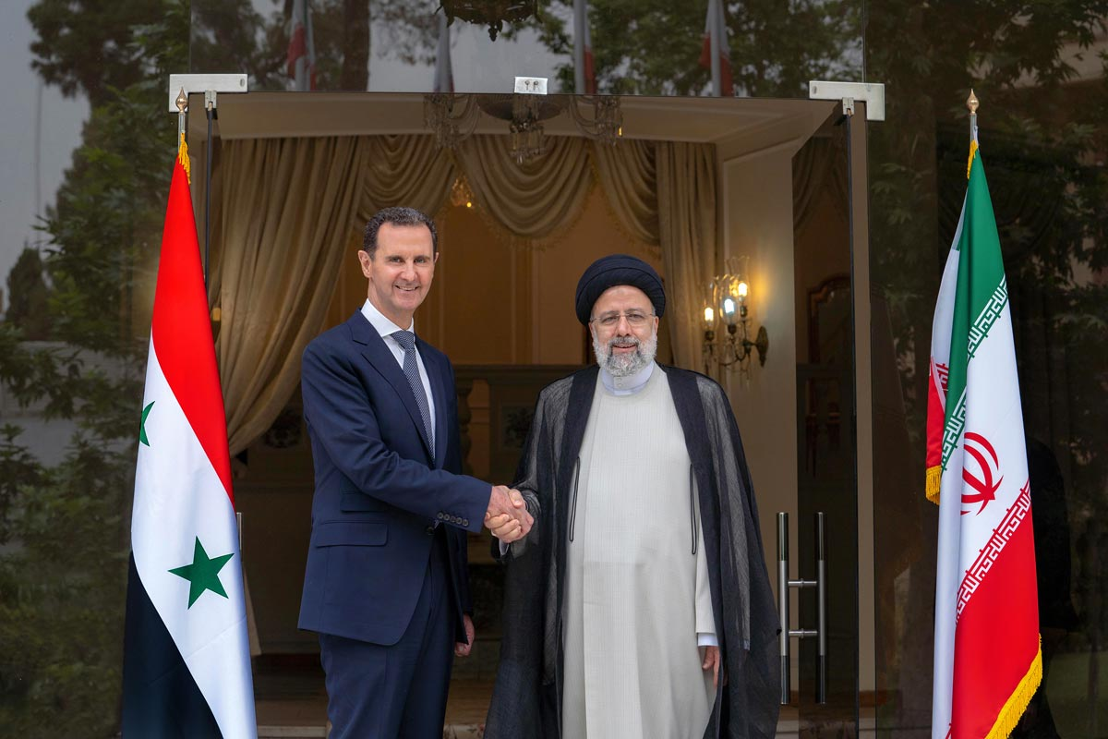
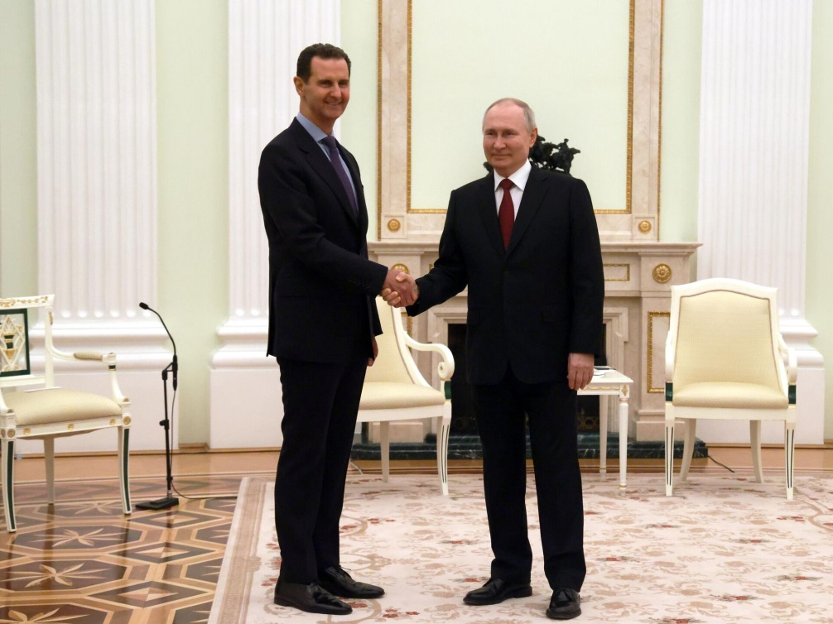
ASSAD REGAINED
CONTROL IN COUNTRY
As Assad regained control of most of the country with the help of key allies Russia and Iran in recent years, some of Syria’s neighbors that hosted large refugee populations took steps towards reestablishing diplomatic ties with Damascus. Meanwhile, Gulf monarchies the United Arab Emirates and Bahrain reestablished ties.

Slide 9
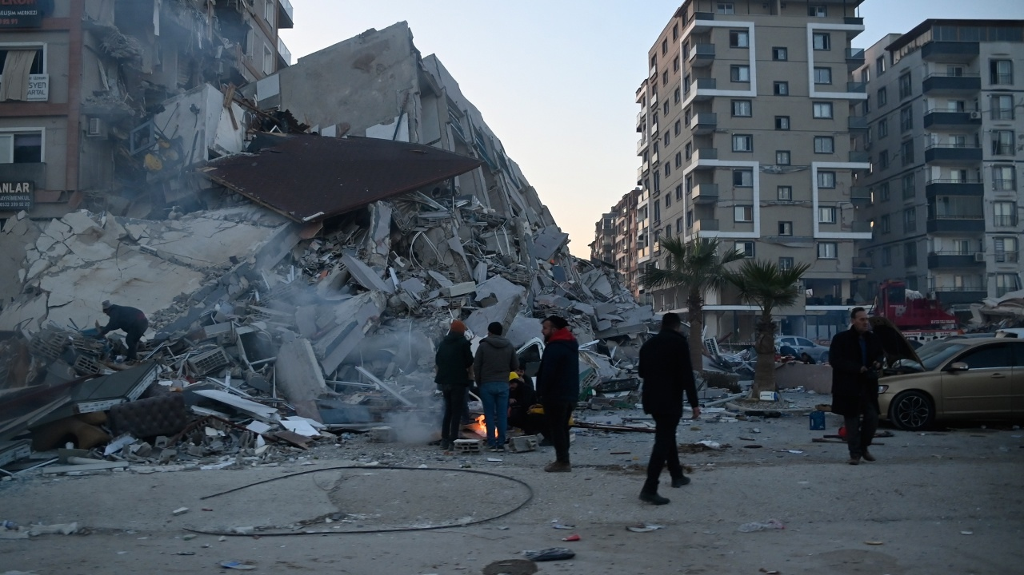
EARTHQUAKE IN SYRIA
The February 6 earthquake that rocked Turkey and Syria was a catalyst for further normalization across the Arab world, including regional rivals Saudi Arabia and Iran reestablishing ties in Beijing, which had backed opposing sides in the conflict.

Slide 10
THANK YOU FOR YOUR ATTENTION!

